Slide 1
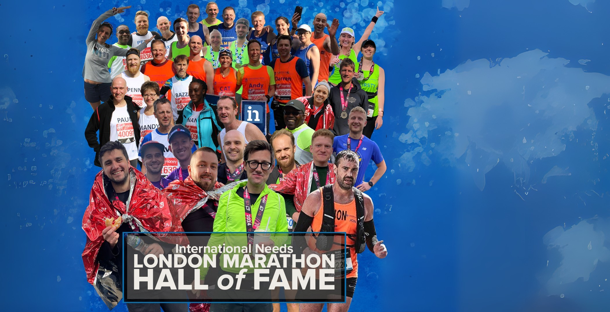



Could you run the TCS London Marathon 2026?
Find out more:
📩 grace@ineeds.org.uk
💻 ineeds.org.uk/london-marathon-2026
scan here

