Slide 1
Notes:
Harvest is a time of celebration and community as we give thanks to God for his generosity. As the church we want to mirror the generosity God has shown us, but in a world filled with so much need it can be difficult to decide what this will look like practically. When it comes to discerning how to give, the questions that need to be answered can feel overwhelming: How can our church make a difference? Who can we partner with? Will our money be used wisely?
This year for our Harvest offering, we have decided to partner with International Needs because we believe they answer all of these questions. International Needs UK is a Christian mission development agency based in South Croydon, who work closely with local Christian leaders and their teams to ensure that funds directly impact families in the local communities they work with. During this Harvest season, INUK is focusing on raising funds for their Livelihoods Programme in Nepal, which is helping families in the Sindhupalchowk District recover and rebuild from the devastating 2015 Nepal Earthquake. Their partner, IN Nepal, is working through a local church planted in the District which is being used to provide livelihoods training and resources to local community members, many of whom lost their means of livelihood in the earthquake.
Before we focus on the different aspects of IN’s Livelihoods Programme and how we as a church can become involved in this story of rebuilding, I wanted to paint a background picture of the effect that the 2015 earthquake has had on this District of Nepal.

Slide 2
Notes:
While the initial epicentre of the earthquake was in the Gorkha District, the highest magnitude aftershock (6.7) took place in the Sindhupalchowk District. Over 3,000 people were killed and over 800 were injured, with an additional 3,000 left unaccounted for. According to the district authorities, over 63,000 houses in this area were severely damaged, and over 90,000 people where identified as in need of assistance based on government reports. This area is very hilly, and the majority of the community members (69.25%) made their income through agriculture. 25% of these families qualify as marginal farmers – meaning that they had land below 0.5 hectares, and only ¼ of it is arable. As a result of these land limitations, even before the effects of the earthquake many of these marginal farming families struggled to create enough income to adequately feed and provide for their children.

Slide 3
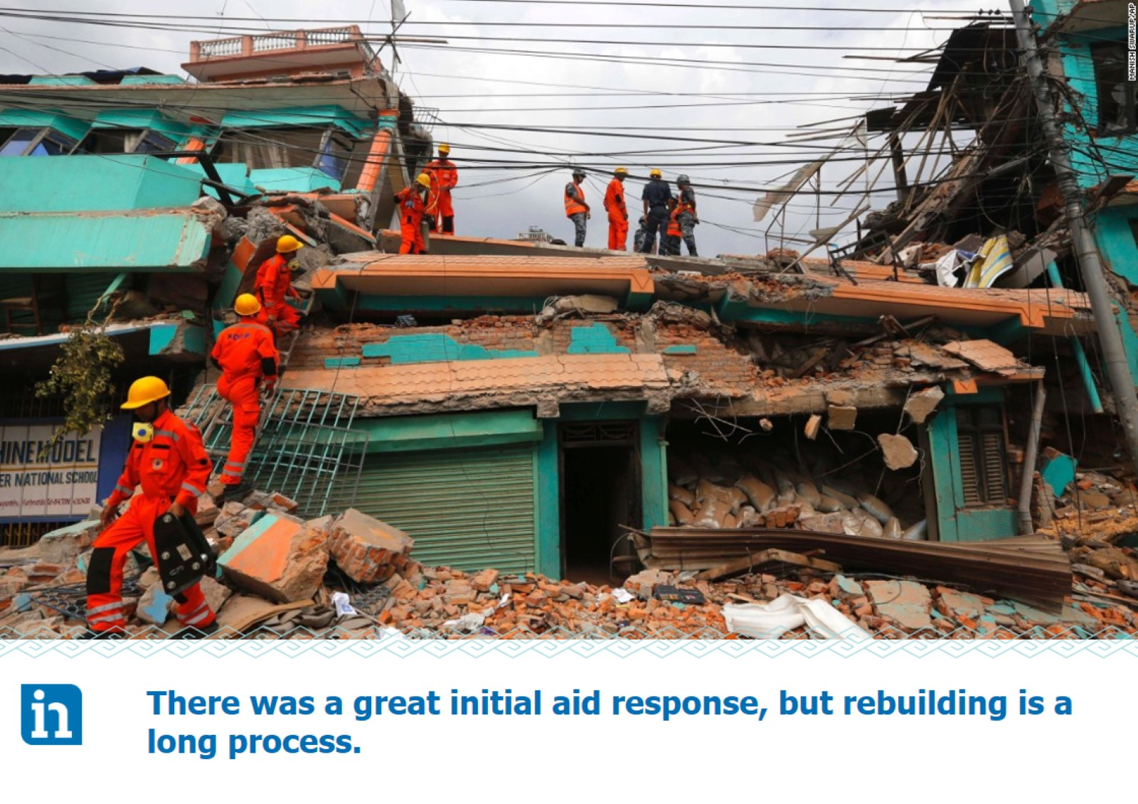
Notes:
While the initial response after the earthquake was very strong, with large charities and governments from all over the world come to Nepal’s aid, four years on that aid has significantly slowed down but there remains much rebuilding to be done.
As we talk about families in Nepal rebuilding after the earthquake, we don’t simply mean rebuilding their homes. As many made their income through agriculture and livestock they literally need to begin again from the ground up. Each terraced hill where they farmed needs to be re-terraced and re-levelled before crops can be resewn. The majority of livestock was also lost in the earthquake and needs to be replaced. It’s difficult to accomplish these tasks when your typical source of income (agriculture) to be able to afford these repairs has been immobilised. INUK & IN Nepal have been working together since the earthquake to come alongside families in the Sindhupalchowk District and provide support and resources as they gradually embark on this extensive rebuilding process.

Slide 4
Notes:
International Needs UK has been active in supporting families in the Sindhupalchowk District since the earthquake in 2015 and has remained working alongside families in Sindhupalchowk to help them rebuild. Through their partners, IN Nepal, International Needs is providing on the ground help to 25 families to establish and expand their own businesses, mainly livestock and agricultural initiatives, as well as some trade entrepreneurships. Over the course of this programme, families have been supported with initial livestock and crop purchases, provided with tailored training about how to increase their yields, build proper livestock sheds and facilities, and have been connected with other families in the community to form local committees that meet together regularly and focus on sharing agricultural lessons learned with one another as well as contribute to a monthly group savings fund which will help families in the face of any future economic or environmental disasters.

Slide 5
Notes:
It’s easy to look at a programme through the lens of numbers. International Needs values monitoring projects effectively and measuring progress and results, but their motivation for every project is helping each family member reach their full potential. Thus far the Livelihoods Programme in Sindhupalchowk has partnered with 25 families to help equip them to rebuild their livelihoods. With the average family size being 5 in this district, that’s 125 people that are directly benefitting from this programme, with many other members of the community indirectly benefiting from an increased level of overall community income, more local resources being grown, and being able to pool their resources together to access better business opportunities within larger markets. Each of these people have a unique story. While we can’t possibly share in one service how this programme has effected each individual, we did want to share a few specific stories of the impact that IN’s Livelihoods Programme has had thus far.
Meet Bhawani – she lives in the Sindhupalchowk District. In 2015, she lost her house and livestock to the Nepal Earthquake. Through the International Needs Livelihoods program, Bhawani has been able to purchase new cows and set up her own business selling milk in her community. She earns a regular income selling milk to a local dairy farmer and creates products such as ghee and yogurt for her neighbours. While there are still many challenges ahead, through the start-up support and training that she has received through International Needs Livelihoods Programme, Bhawani has been able to earn enough income to cover her family’s basic needs and cover her son’s education costs. She is now helping her neighbour set up a similar business.

Slide 6
Notes:
A core value of the IN Livelihoods Programme is working in partnership with local community members, rather than a top-down model. As such, IN Nepal workers on the ground dialogue with community members in the Sindhupalchowk District about what type of business they would like to pursue. While many opt for agricultural ventures, some have pursued trade training, which brings another level of diversity to business in the local area and further means of trade. Santosh (pictured here) He doesn’t own enough land to make a profit from producing crops so through the Livelihoods Programme he is pursuing carpentry. He learned the trade as an assistant and now is able to earn an income through his own furniture making business through the support of the IN Livelihoods Programme which has provided him with different tools and machinery. He is now able to make enough income to provide for his family’s basic needs, including his children’s education. Sometimes his services are in so much demand that he needs to hire assistants, which creates further local jobs for members of the community who can learn from the knowledge he has gained through the Livelihoods Programme.

Slide 7
Notes:
The first phase of the Livelihoods Programme, which helped 125 people in the Sindhupalchowk District establish their own entrepreneurial endeavours has just finished. INUK and IN Nepal will be working together across the next three years with the goal of increasing the scope of this programme to be able to help a further 75 families, making 100 families in total. This means we will be providing livelihoods support to approximately 520 individuals across four local communities made up of 3,000 residents. We are excited at the far-reaching positive effects the Livelihoods Programme will have on the overall economic opportunity and quality of life for families in this area.
The main goals of the programme are that : parents will be able to better provide for their children’s education and well-being, children will be well nourished through increases in household income through vegetable production, and livestock and small-scale business and project beneficiaries are better able to manage their basic needs, withstanding any future shock or disaster through increased resilience. In 2020, the Livelihoods Programme will need an estimated £70,000 to help establish and equip more families towards independent livelihoods.

Slide 8
How Our Church Can Join This Story of Rebuilding
Notes:
As families in the Sindhupalchowk District are working together and learning from one another, the IN Livelihoods Programme is something that no one church or individual can support. It will take a coming together and sharing of our resources to those that have a need, like the original church did in Acts, to see this goal accomplished. How can we as a church come alongside families in Sindhupalchowk and help them rebuild? (Each church leader can expand their own ideas for doing this here.)

Slide 9
Prayer Points
Notes:
We know that God can do abundantly beyond what we ask or think (Ephesians 3:20). Regardless of what you may or may not give today, would you please pray for the families in the Sindhupalchowk District involved in the Livelihoods Programme? Here are a few specific ways you can do that.

Slide 10
A Message From INUK
Notes:
As I mentioned earlier, the heart of every IN project is to help each family member have access to basic resources so they can reach their full potential. They wanted me to express their gratitude for partnering with them to help make this vision a reality – one life at a time.

Slide 11
Get in Touch
Notes:
If you would like more information about the Livelihoods Programme in Nepal, INUK would love to hear from you.

